Slide 1
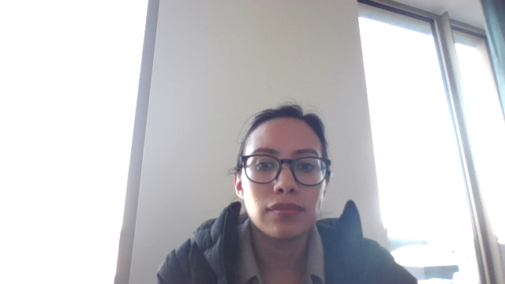



Data cleaning & standardisation in R
Laura Márquez
Salvador Fernández
September 28th, 2022
Notes:
Hello,
Welcome to the 3rd session of this Research data management workshop, brought to you by VLIZ and LifeWatch.
First of all, a big thank you for coming to this workshop and let’s start with the content.

Slide 2
What we will learn in this session
Importance of clean data
Intro to standards in biodiversity & its importance
Exercises!
Notes:
During this workshop we are going to learn on the importance of cleaning & standardizing the data in the field of science, we will have a short introduction to standards in biodiversity and we will get our hands on some exercises and learn a couple of functions in R useful to clean & standardize data.

Slide 3


FAIR principles
Common Data Elements: Standardizing Data Collection (nih.gov)
Notes:
A major barrier to why researchers in the life sciences don’t share their data is because of the daunting prospect of standardizing research data and the amount of work it presents. But if your data have a recognizable and common structure with formal terminologies for description, it wont be limited on how it can be used. By standardizing your data and making it compatible and interoperable, you can contribute to the FAIR principles. Also, there are institutions and organisms that can provide guidance and assist you to do it.

Slide 4
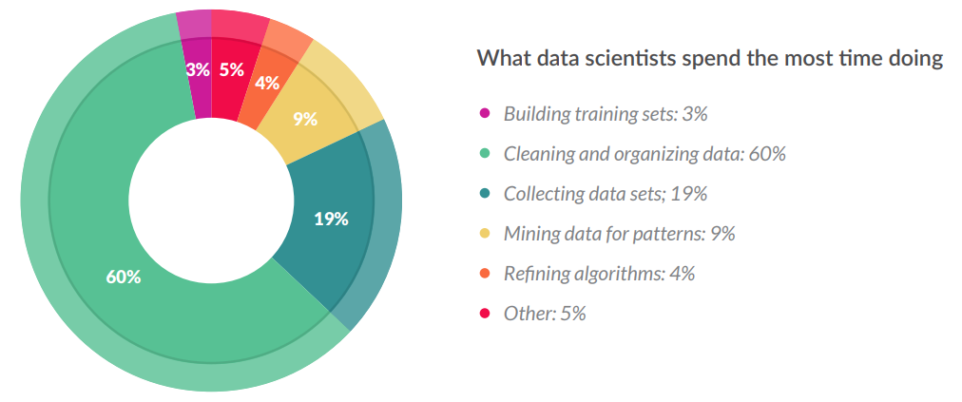
Most time goes to data wrangling
60% time cleaning & organizing!
CrowdFlower_DataScienceReport_2016
Notes:
Lets go to an example on how lacking of data cleaning and organizing affects affects for example the data scientists. Generally, we think of data scientists building algorithms, exploring data, and doing predictive analysis. That’s actually not what they spend most of their time doing. 3 out of every 5 data scientists actually spend the most time cleaning and organizing data, up to 60% percent of the time. Messy data is by far the more time-consuming aspect of the typical data scientist’s work flow.

Slide 5
More on data cleaning time
“Students in PhD programmes spend up to 80% of their time on ‘data munging’, fixing formatting and minor mistakes to make data suitable for analysis — wasting time and talent.”
Invest 5% of research funds in ensuring data are reusable (nature.com)
Notes:
Now let’s consider for researchers. If data are treated properly, researchers will have significantly more time to do research. Making sure that others can access data is an ethical issue but not only that. Students in PhD programmes spend up to 80% of their time on ‘data munging’, For example, if you consider 400 students, that would amount to a monetary waste equivalent to the salaries of 200 full-time employees, at minimum. Instead, hiring 20 professional data stewards to cut time lost to data wrangling would boost a more effective research capacity. Because of that, many top universities are starting to see that the costs of not sharing data are significant and greater than the associated risks.

Slide 6
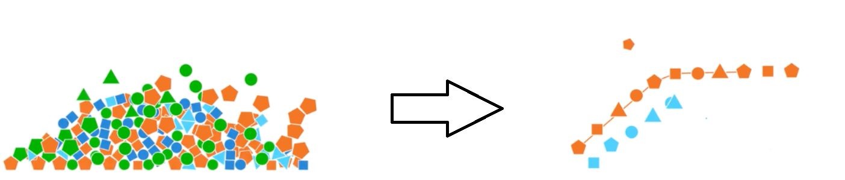
Data cleaning
Spell checking
Finding & replacing errors
Handling missing values
Merging and splitting columns
Joining tables
Tidy data
By ChrisJen517/ CCBY
Notes:
Of course, it is not the case that you don't always have control over the format and type of data, specially when you imported it from an external data source, such as a databases, text file, or a Web page. That’s why it is so important that before analyzing the data, you often check for the scope of it and in several cases it will be needed to clean it up. Here you can find a short checklist on the actions to take to do data cleaning.

Slide 7
Sources for this session
LINK TO BINDER/ RStudio

Slide 8
Tidy data
Quick reminders on tidy structure:
each column a variable
No colors, fonts, italics
id | name | age
No spaces or $peci@l characters
each row an
observation
Consistent names & good null values
Dates YYYY-mm-dd
Avoid using multiple chunks of data
Easy to read formats
INTEROPERABILITY
Notes:
Before starting let’s have a short review on tidy data…as a reminder this is a type of structure that helps us to make the data interoperable, making it much easier to analyze it later. A quick list of its characteristics is that it has one column for each type of observation and one row for one observation. The data has consistent names without special characters or spaces. And good null values. It does not use color coding or fonts. The dates are in format year with 4 numbers Hyphen-minus month Hyphen-minus day. It avoids duplicated chunks of data & use easy to read formats.

Slide 9

Time for exercise!
Notes:
In the next part of this session, we will be working to clean and standardize this dataset…….lets go to our R session

Slide 10
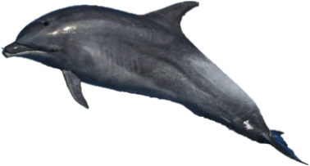
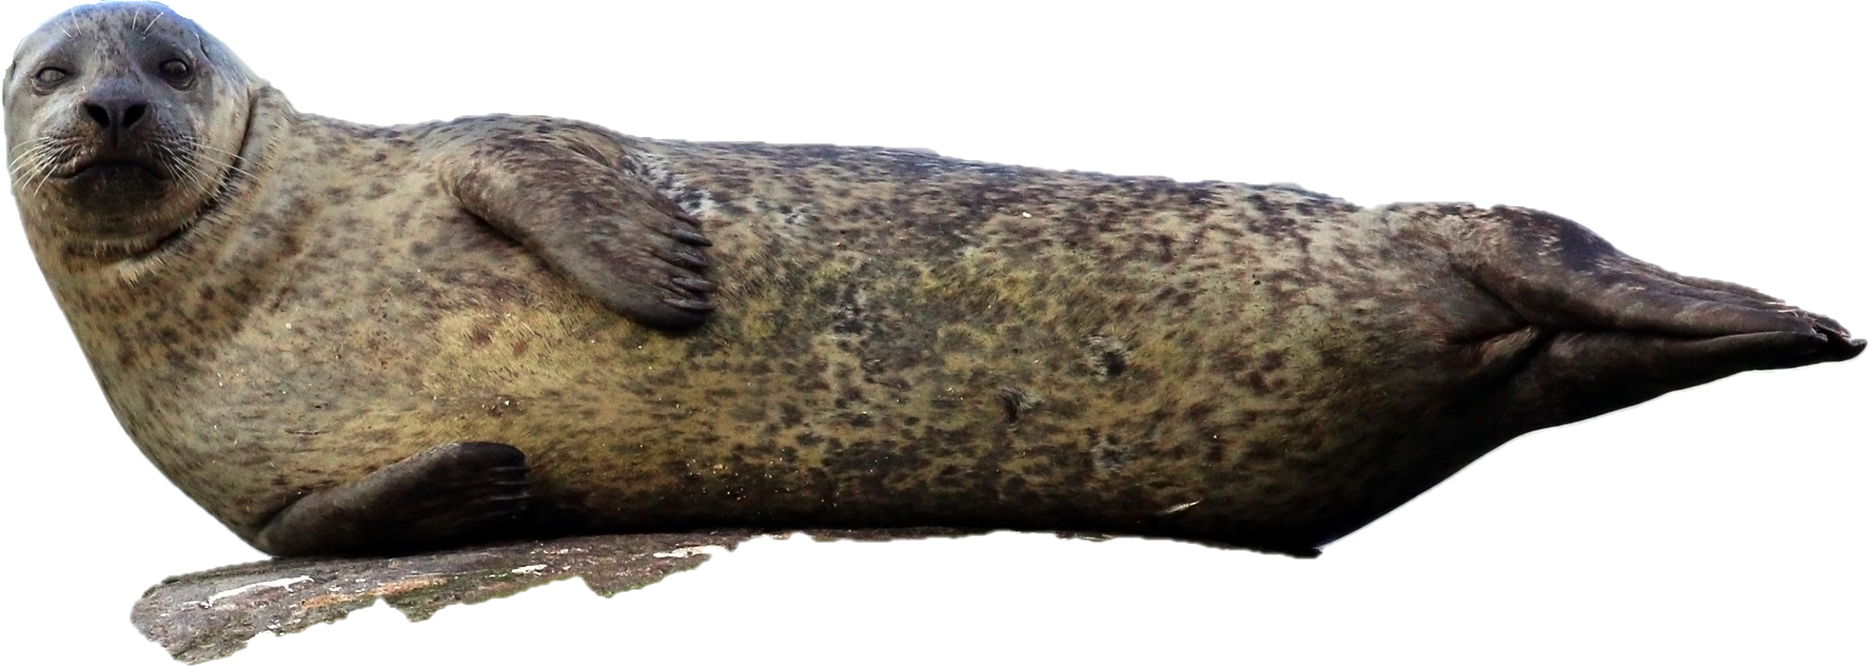
Exercise dataset
Derived from Laurent/ommag/ CCBY
Dataset title: Explore the shore example
Geographical coverage: Ireland
Parameters: Abundance, Sea surface Temperature
Taxonomic coverage: Mammalia
Citation: Flanders Marine Institute (VLIZ), Belgium. (2022). Explore the shore example. https://doi.org/10.xxxxx/xxx
Derived from Charles J. Sharp/ CCBY
Notes:
Now that we got a short review in tidy data, let’s get hands on our exercises. We are going to be working with an example dataset, the way to know more about it is to check the metadata: the WHAT, WHERE, WHEN, HOW, WHY and the WHO of the data. Here we are showing you some of the metadata so that you can easily tell what the dataset it about, a short reminder on the importance of the metadata. Could somebody help to tell us what it is about.

Slide 11
Exercises part A
Open the file and look at the scope of the data, something strange with the site names? *use unique()
Identify mistyping errors in the site names and correct them *use str_replace()
Delete special characters and spaces from the data *use str_replace()

Slide 12
Key R functions to use in data standardisation
select()
filter()
mutate()
transmute()
%>%
Notes:
# select – help us select specific columns
# mutate - add columns to the dataframe
# transmute – créate columns, but only those columns in specific
# filter which is useful to select specific rows

Slide 13
Exercises part B
Standardize the dates in IS0 8601 standard (YYYY-mm-dd) *use separate() & mutate()
Use pivot function to get your data tidy (one observation per row) *use pivot_longer()
Drop the unnecessary columns *use select()

Slide 14
Recap
Data cleaning is an essential before handling, analyzing, etc.
Making your data tidy is a great way to make data interoperable (and to share it with colleagues)
In R, tidyverse is a useful package to help you handling data.
Upcoming…standardization in biodiversity!

Slide 15
Lunch break
Notes:
In the next part of this session, we will be working to clean and standardize this dataset…….lets go to our R session

Slide 16
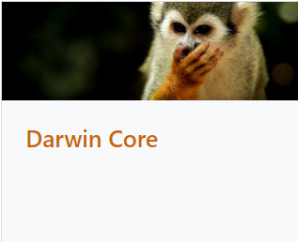

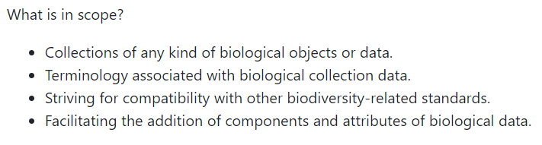
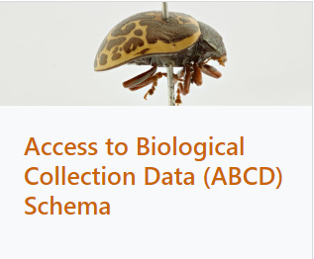
Standardisation
Standards in biodiversity
Darwin Core quick reference guide
Check many more standards Standards - TDWG
Notes:
[3 min] After our lunch break, now we will go more in depth into the standardization part. There are different standards in biodiversity. These standards were built according to the priorities of the use cases which they were designed for, it could be for example to compare and exchange data with each other without loss of information due to incompatible geographical boundaries (WGSRDP), to facilitate the sharing of information about biological diversity (Darwin Core), to represent tissue, DNA or RNA samples associated to voucher specimens, tissue samples and collections (GGBNB), for recording the relationship between a plant and a place (POSS).
Here are two of the most representative and widely used for collecting data & observations in biodiversity: Darwin Core which we already mentioned is useful to facilitate the sharing of information about biological diversity (Darwin Core), and ABCD that is an evolving comprehensive standard for the access to and exchange of data about specimens and observations

Slide 17
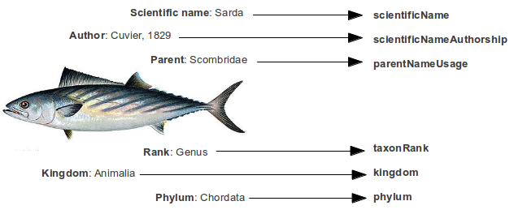
Standardisation
Standardizing the structure of the dataset: term names
Darwin Core quick reference guide
By Valentina Marioli
Notes:
[1 min] For this exercise we are going to be using the Darwin Core standard, since it is one of the most widely used. Darwin Core includes a glossary of terms (in other contexts these might be called properties, elements, fields, columns, attributes, or concepts) intended to facilitate the sharing of information about biological diversity by providing identifiers, labels, and definitions. Primarily it is based on taxa, their occurrence in nature as documented by observations, specimens, samples, and related information.

Slide 18
Time for exercise!
Notes:
In the next part of this session, we will be working to clean and standardize this dataset…….lets go to our R session

Slide 19
Standardization
1. Standardizing the structure of the dataset: normative term names
observationNumber
eventDate
date
Location
Latitude
decimalLatitude
Longitude
decimalLongitude
SiteName_clean
scientificName
Darwin Core quick reference guide
species
individualCount
abundance
recordNumber
Notes:
[5 min] First we will be standardizing the general structure of the dataset. For this we will identify the normative term names (a.k.a. the name of the columns) that we would use according to the Darwin Core Standards. The exercise will be to take the name of the original column of DataAbundance and try to match them with the correct Darwin Core term. Could someone help us with any example?

Slide 20
Exercises part C
Modify DataAbundancew column names to fit the Darwin Core column names * use rename()
Notes:
[5 min] Now that we have clear what is the structure of the dataset, in R we are going to modify our example dataset to have the correct column names

Slide 21


Data standardisation
2. Standardizing data points: taxonomic quality control & georeferenced standards
Notes:
[1 min] Apart from standardizing the structure of the data, we can also standardize the information of the data points. Just like in the general structure, there are different types of standardization that you could apply. For example, to standardize the name of the species, the geographical locations of your dataset and even the stuff that you measured from them.

Slide 22


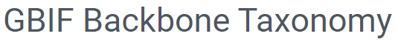


Data standardization: Taxonomic quality control
To check more authorities: GBIF Backbone Taxonomy
Notes:
[2 min] To standardize the species names, there are different authorities that you can consult to accurately manage the names of the taxa you are working with. There are different lists depending on the taxa or the type of data that you are dealing with. For example, if them are marine, if they are vascular plants, flies, DNA, fossils or more. You can check more authorities on the link at the bottom of the slide. Some of them are more widely used than others. Apart from the lists, there are also integrated backbones that include names from different authorities to integrate the information from different resources

Slide 23
Data standardization: Taxonomic quality control
WoRMS -Tursiops truncatus (Montagu, 1821)
Tursiops truncatus
Notes:
[2 min] In this example, because we are working with marine data, we will be using WoRMS to standardize the names of the species. WoRMS, stands for the World Register of Marine Species (WoRMS) is the main authority on marine species for Europe and it provides a comprehensive list of valid names of marine organisms, including information on synonymy. WoRMS uses APHIA, which is the name of the database in which all the WoRMS data are stored. Each species is linked to and ID and to a Life Sciences Identifier (LSID), this is an approach to naming and identifying data resources, and every taxa has its own unique LSID.

Slide 24
Time for exercise!
Notes:
In the next part of this session, we will be working to clean and standardize this dataset…….lets go to our R session

Slide 25
Exercises part D: taxon quality control
Use worrms library to obtain the LSID of each species and put them in a new column named “scientificNameID”
* use wm_records_taxamatch
* once you obtained them, use “do.call(rbind, myspeciestable)” to transform the tibble to data frame
* use left_join to ONLY add the species
Notes:
[10 min]

Slide 26
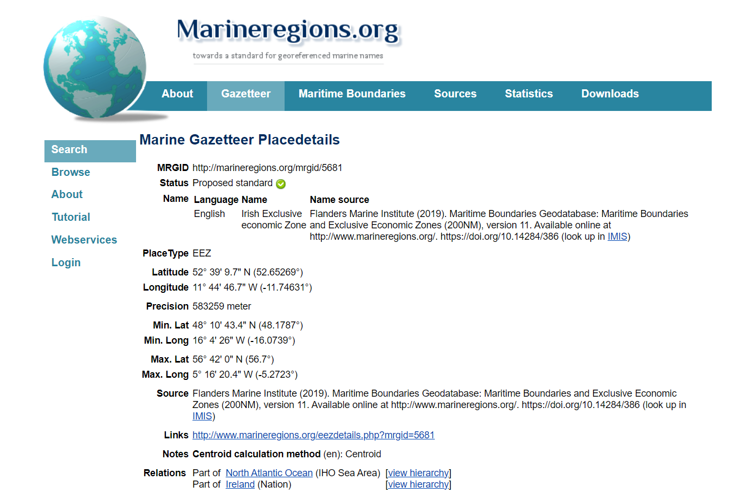
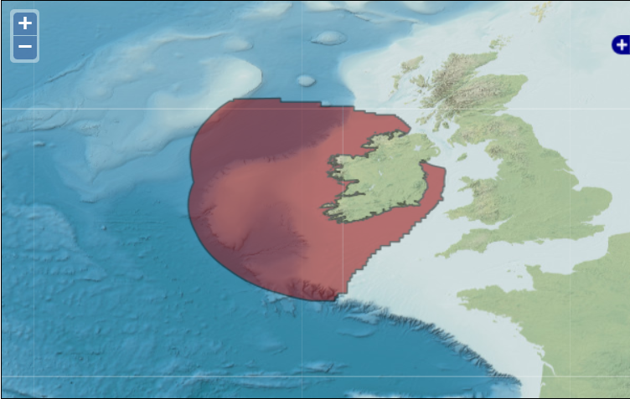
Data standardization: Marine georeferencing
Marine regions Gazeetter
MarineRegions R client (github.com)
Notes:
Geographic Information Systems have become indispensable tools in managing and displaying marine data and information. For standardization, we have a tool available for georeferencing different parts of the world, mainly marine regions, but not limited to it. Marine Regions is a standard and relational list of geographic names. It contains information and maps of the geographic location of these features. You can do a search using our gazetteer or in the future also through the R package marine regions, at the moment you can use our current version by accessing the marine regions github.

Slide 27
Time for exercise!
Notes:
In the next part of this session, we will be working to clean and standardize this dataset…….lets go to our R session

Slide 28
Exercises part E: Marine georeferencing
Use marineregions to search for the correct id of the region and put it in a new column (locationID)
Notes:
For our last exercise we will be using marineregions to search for the correct id of the region and add a new column to our dataset. This column name will be “locationID”. Since this exercise is a bit more complicated we will give you an extra (and free of charge) line of code for you complete the exercise.

Slide 29
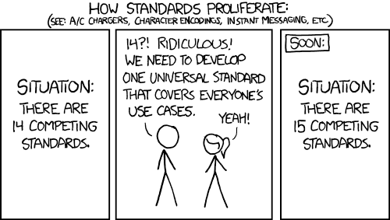
Yes, many standards…
By xkcd/ CCBY
Notes:
I know I know, just like this comic shows (read it), it could seem as if there are so many multiple standards that they seem to be competing with each other.

Slide 30
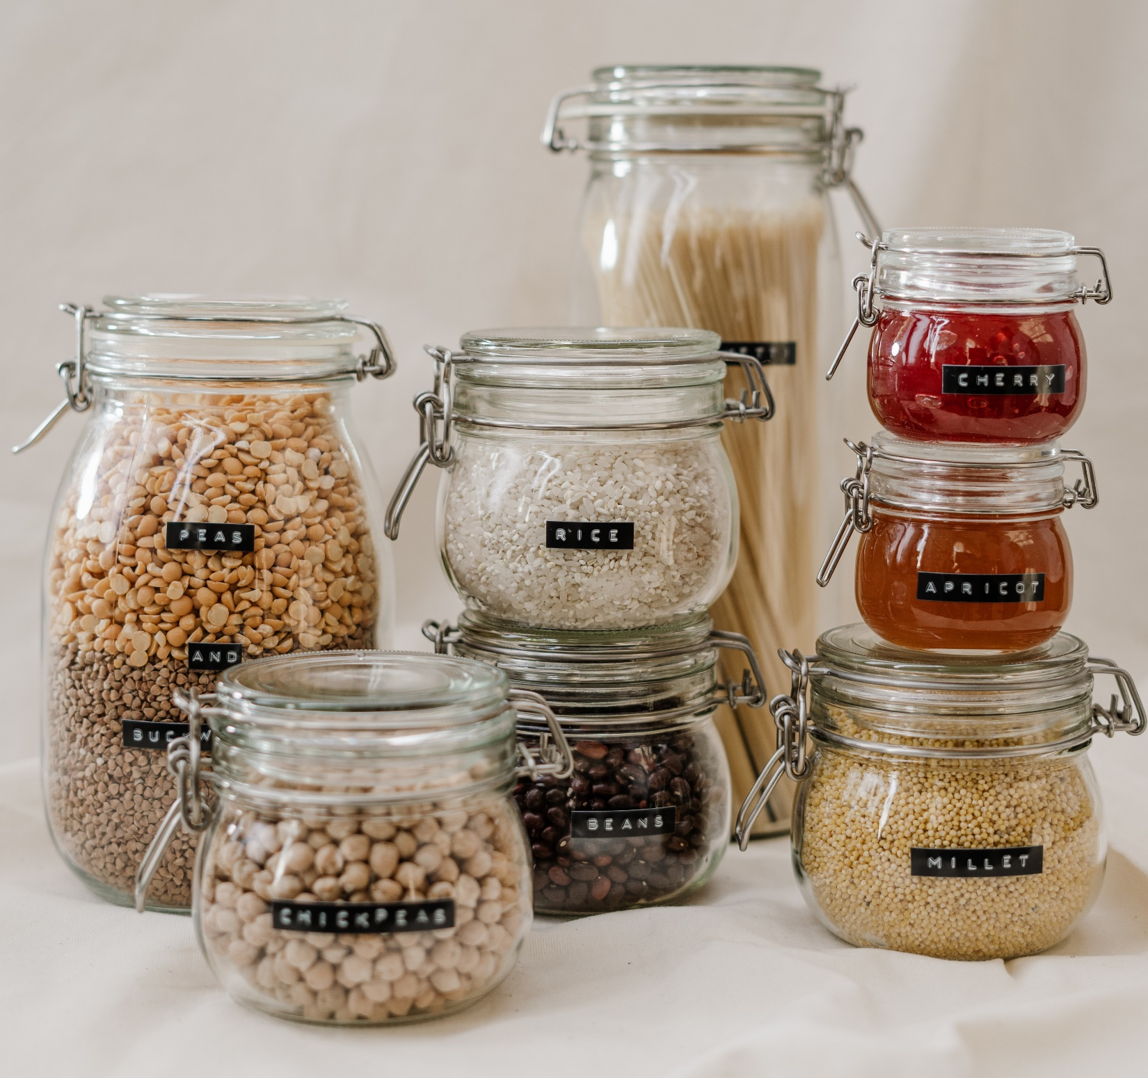
They work as containers where you can fit in your data!
DARWIN CORE
ABCD
WGSRPD
AUDUBON CORE
TAPIR
WGSRPD
GUID
your data
his data
her data
their data
Derived from Glass Jars With Food/ CC
Notes:
But the beauty of them is that they can be as flexible as you data is. Remember that there are many many different types of data and that is the reason why there are so many types of standards, to fit in YOUR data. And also don’t forget that there are institutions and organisms that can provide you with their guidance and assist you to do it.

Slide 31
Summary
Data cleaning is an essential before handling, analyzing, etc., using R makes it easier
Making your data “tidy” is a great way to make data interoperable (and to share it with colleagues)
In R, tidyverse is a (collection of) package to help you handling data.
In biodiversity, there are different standards useful for sharing your data, such as Darwin Core or marine regions.
Standards are helpful to make sure we are all in the same page!
Notes:
Still need adjustments

Slide 32
Further reading
www.lifewatch.be www.marinespecies.org www.marineregions.org Course: Contributing datasets to EMODnet Biology Best Practices in Publishing Species Checklists :: GBIF IPT User Manual The OBIS manual

Slide 33
THANKS!

Slide 34


For further questions you can contact us:
Salvador Fernández
salvador.fernandez@vliz.be
Laura Márquez
laura.marquez@vliz.be

